Slide 1



Jasmine website

Slide 2

What is Jasmine website?
It is a dynamic website that helps customers find products from Jasmine company. You could use this website on Safari, Google Chrome, Microsoft Edge, Mozilla Firefox, and Internet Explorer web browsers.
On this website, you could select underwear or buy a gift card. Our customers have their own cabinet where store all information about orders, personal data, and wish lists.
Of course, you have the capability to contact our helpdesk, if you need help. It’s really important that our customers could quickly look over lots of product photos and choose the correct size, color, and model. Then successfully buy it.

Slide 3
AGENDA
Functional testing
Smoke testing
Functional testing EXAMPLE #1
Functional testing EXAMPLE #2
Non-functional testing
Performance testing
Stress
Localization testing (L10N)
Internationalization (I18N)
UI testing
Usability testing
Security testing
Compatibility
Change related testing
Confirmation testing
Regression testing

Slide 4
SMOKE TESTING
Task: Test the new version of Jasmine’s website
Smoke Testing Procedure: quickly check the main website’s features (run the website, check the search field, try to buy a product, log in, send a message to the helpdesk, and check if it will be successful).
Summary: Build is accepted, and critical bugs are not found.

Slide 5
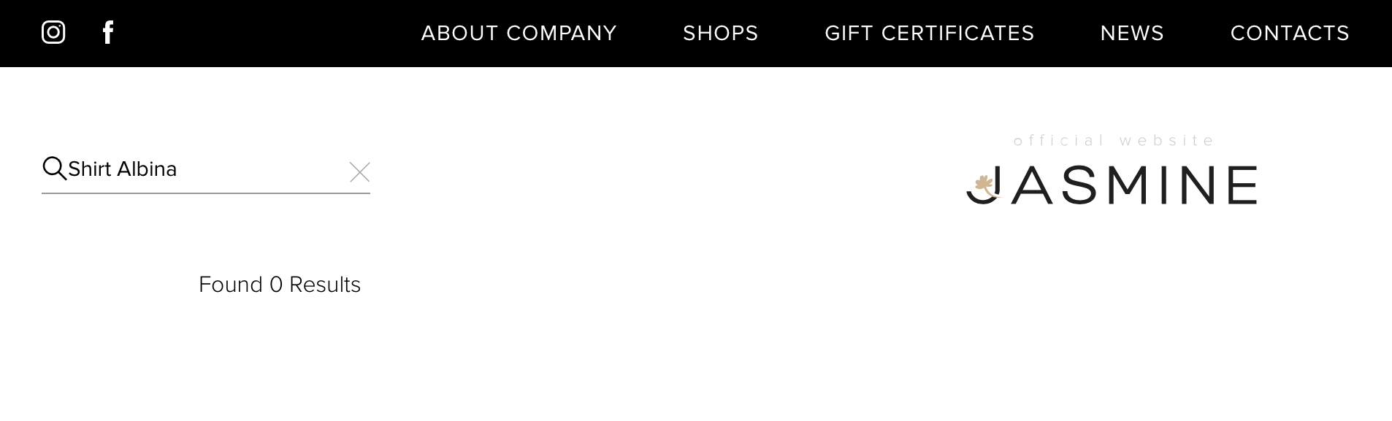
FUNCTIONAL TESTING. EXAMPLE #1
Task: Test the ability to buy a product
Functional Testing Procedure: Check the ability to buy a Shirt Albina, color: black, size: M
Type in a search field category and name of the product, chose details, and try to order.
Defect: After searching, the product doesn’t appear in the list.

Slide 6
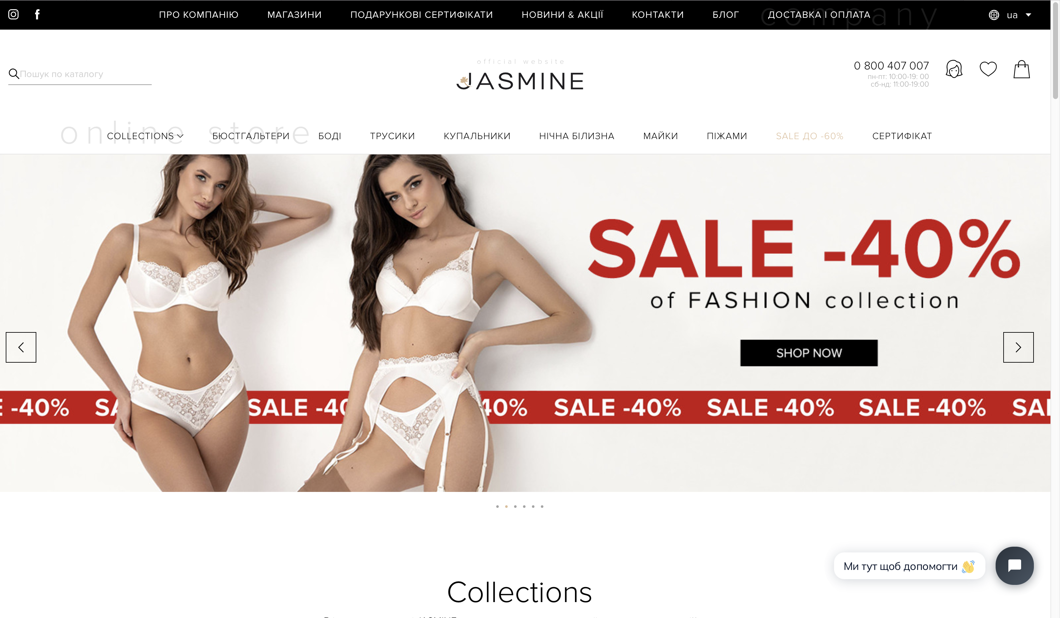
FUNCTIONAL TESTING. EXAMPLE #2
Task: Test ability to log in
Functional Testing Procedure: Check the ability to log in on the webpage. Click on the button login, open a new page, chose new customer, enter your details, then sign up.
Result: Pass

Slide 7
NON-FUNCTIONAL TESTING: LOAD
Task: The server should respond in less than 2 sec when up to 100 users access it concurrently.
Load Testing Procedure: Check the response time of the server with 100 users accessing it at the same time from different devices. (Jmeter)
Result: Pass

Slide 8
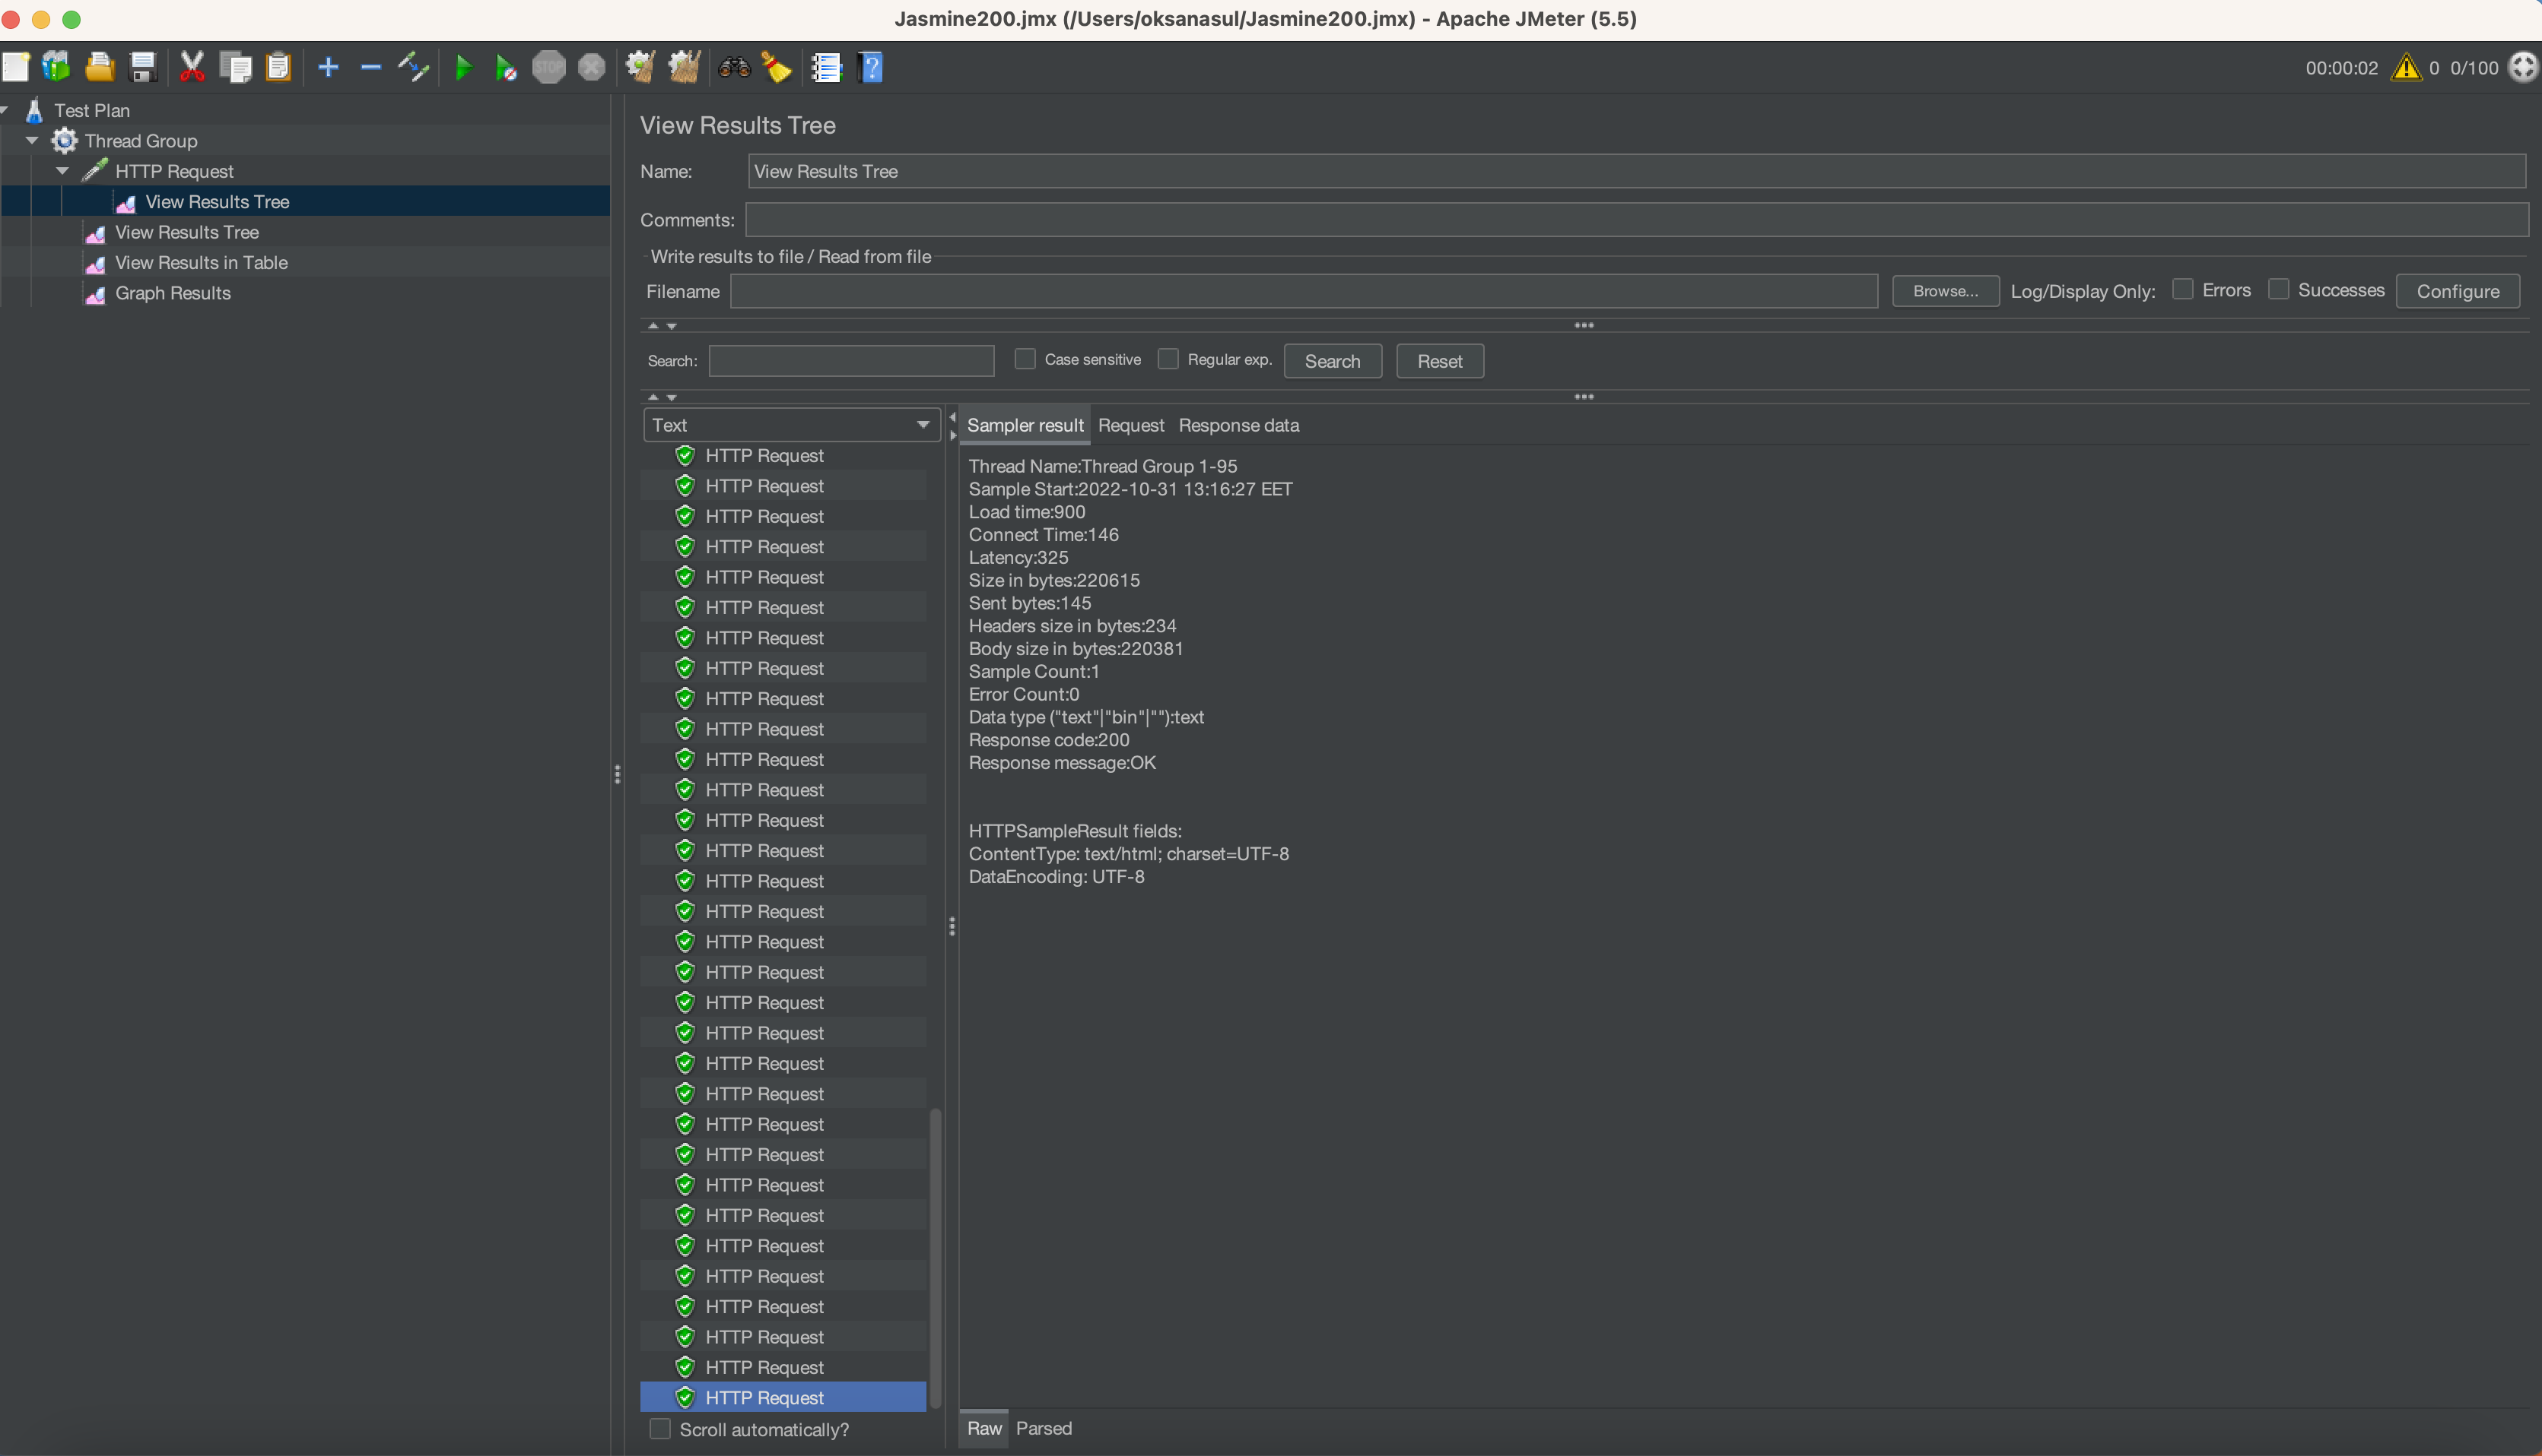

Slide 9
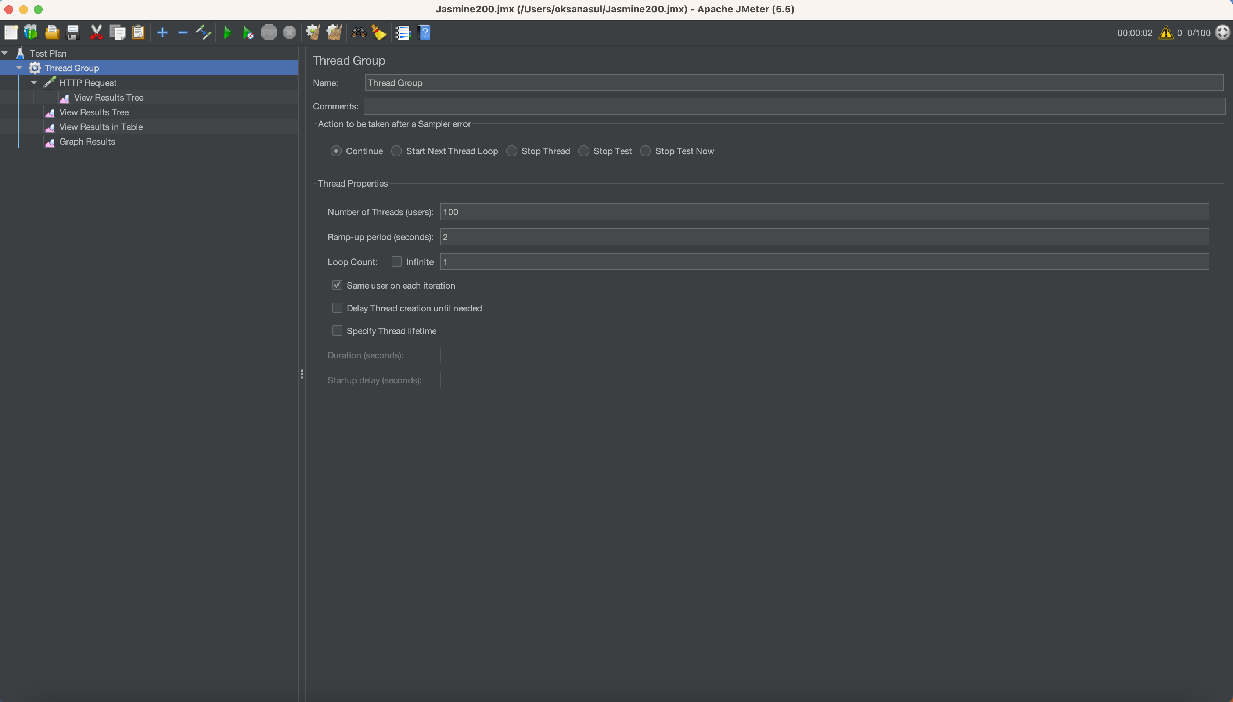

Slide 10
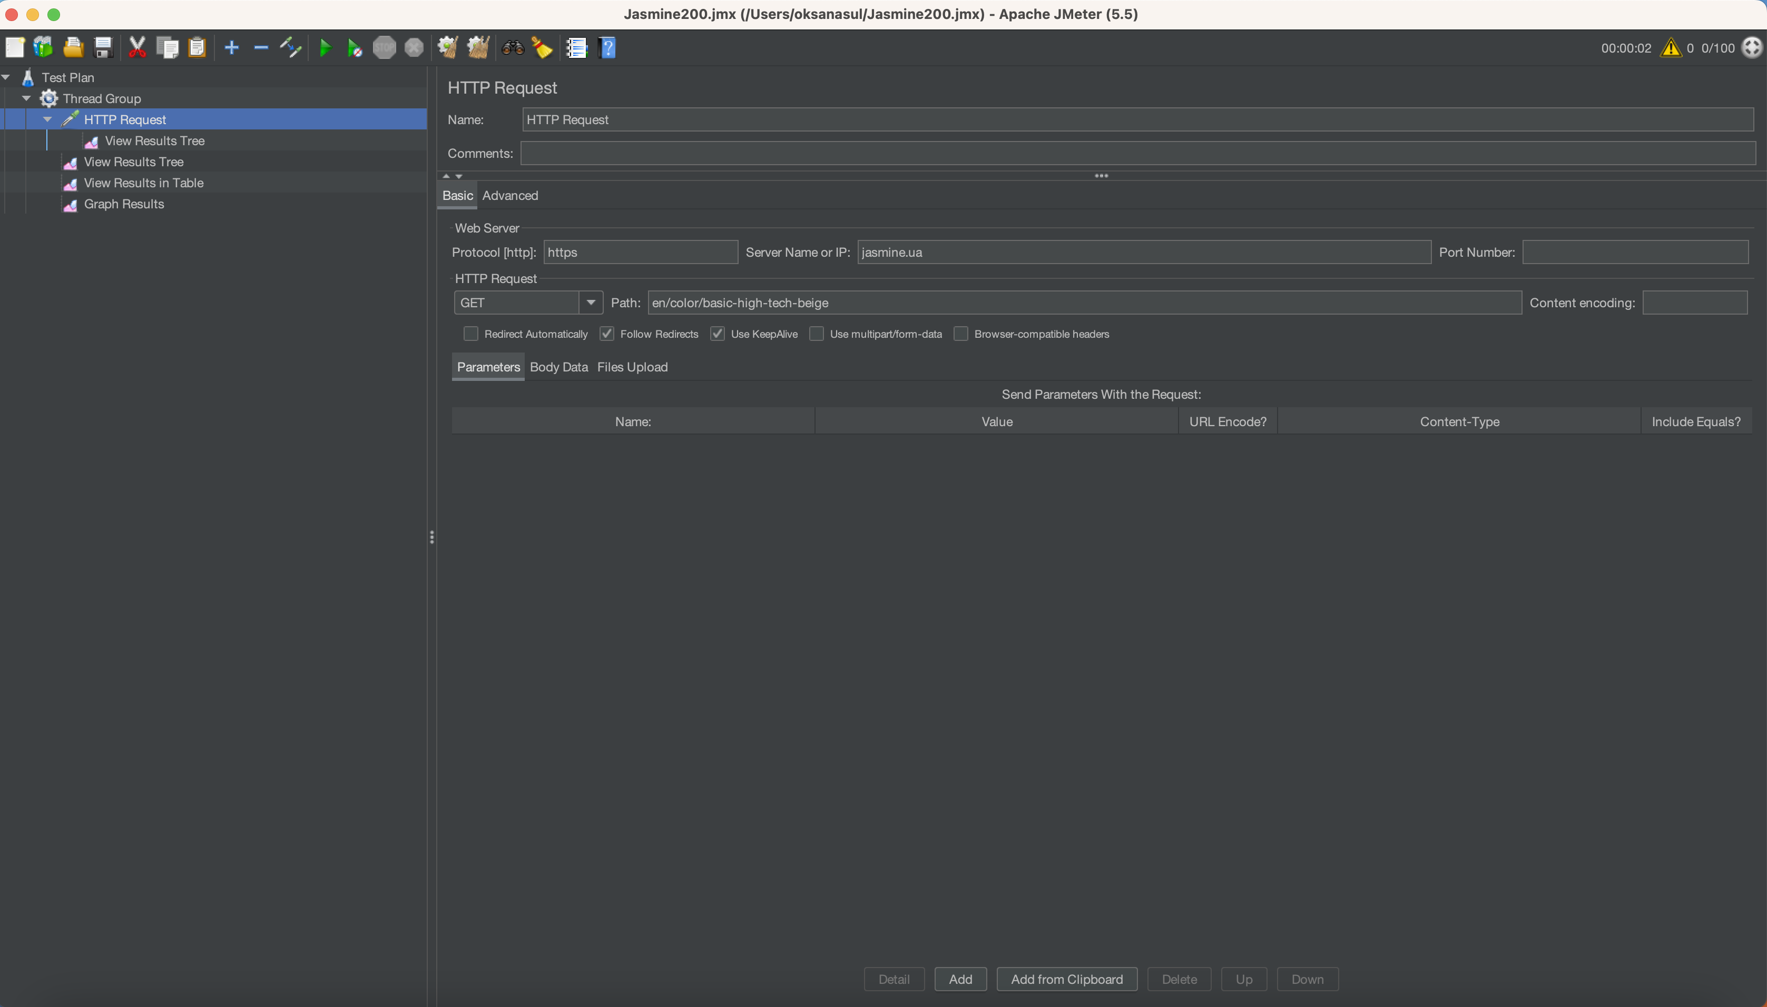

Slide 11
NON-FUNCTIONAL TESTING: STRESS
Task: Test, if website behavior is correct when the user tries to buy more than 150 products (over application requirements).
Stress Testing Procedure: Try to buy more then150 products. Verify that the website works correctly, it should not crash due to overload, users should get the appropriate message.
Defect: The application has sent an incorrect message.

Slide 12
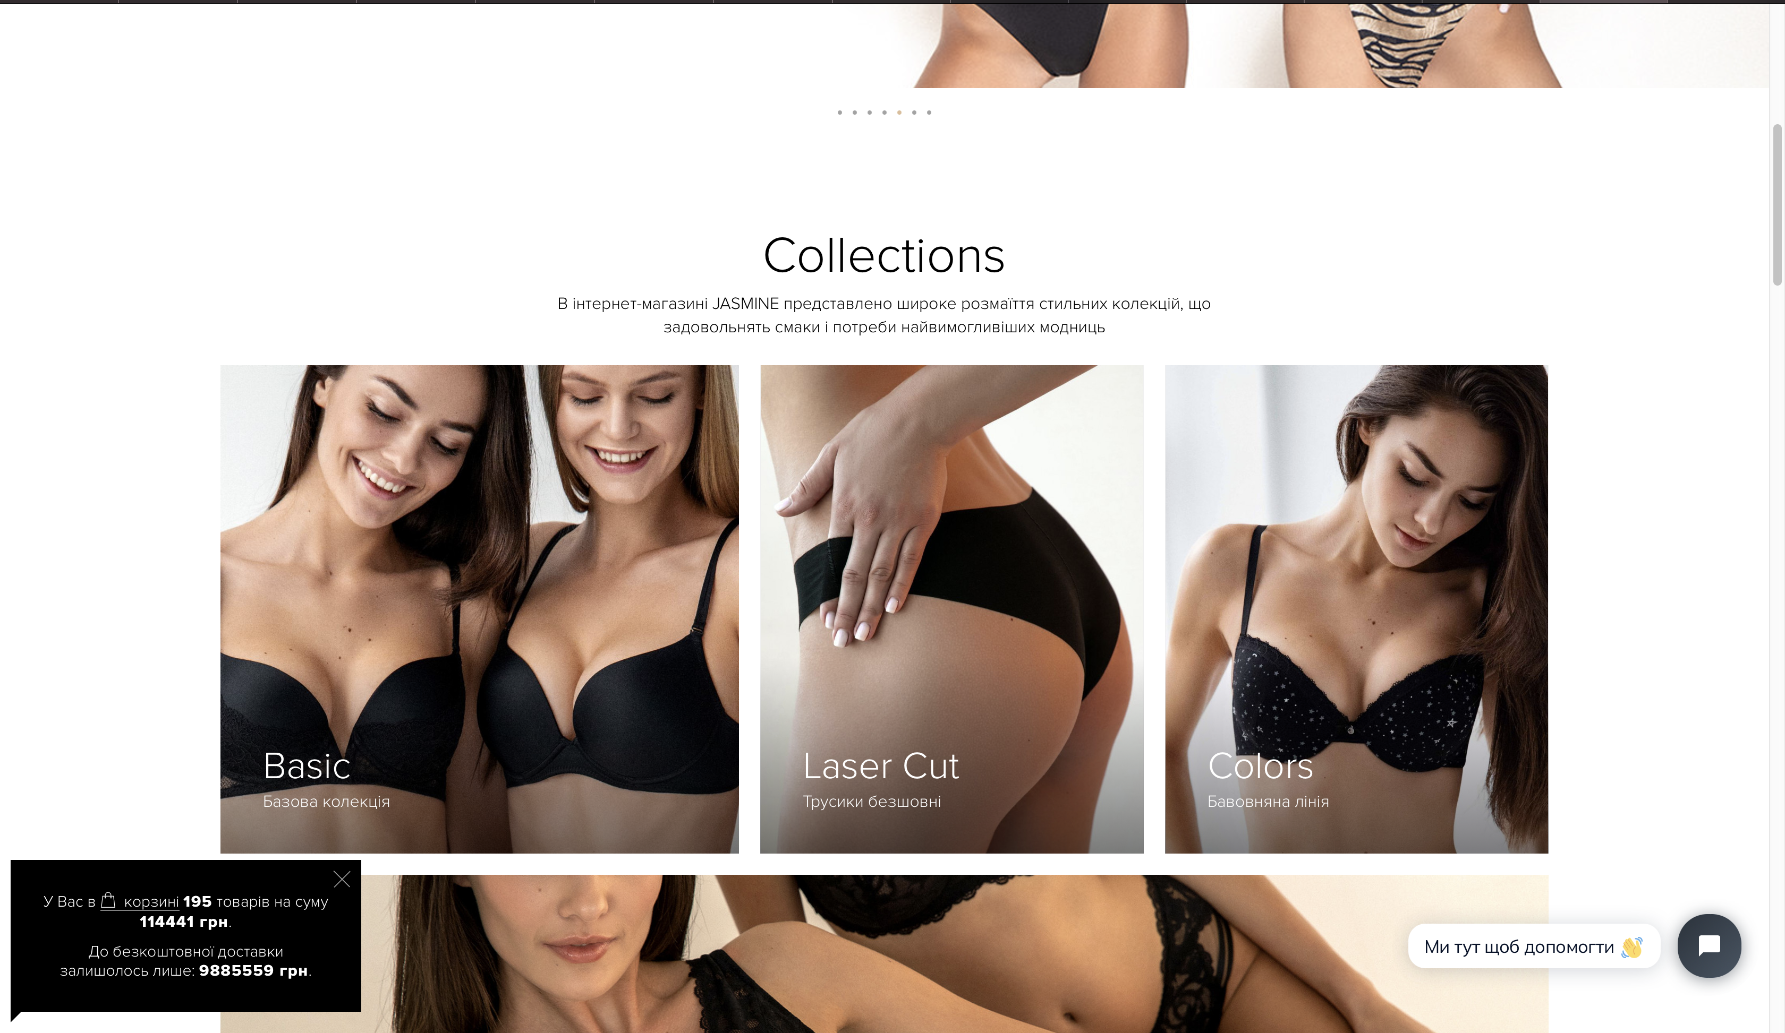

Slide 13
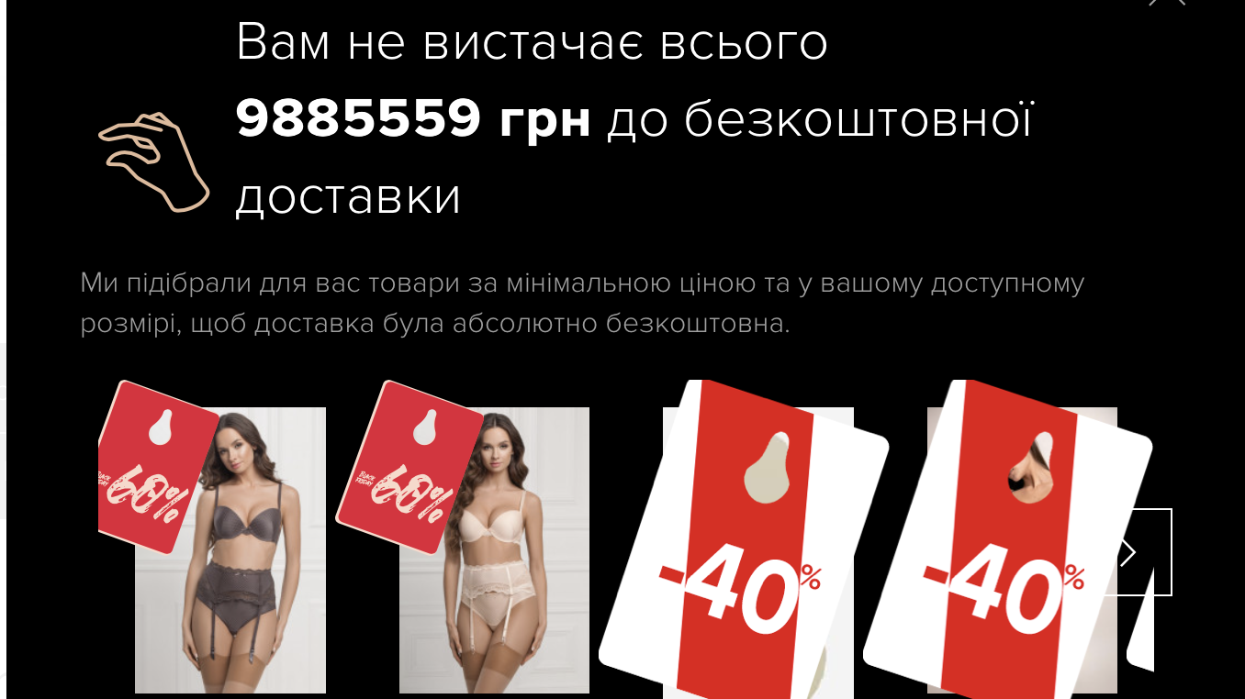

Slide 14
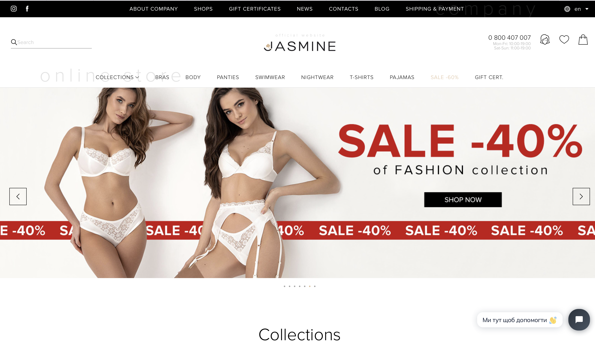
NON-FUNCTIONAL TESTING: L10N
Task: Verify that after changing language settings on the website home page menu items are translated correctly.
Localization Testing Procedure: Open the home page, log in, change the language to English and check the displayed text whether the translation is correct.
Defect: Button helpdesk support isn’t translated.

Slide 15
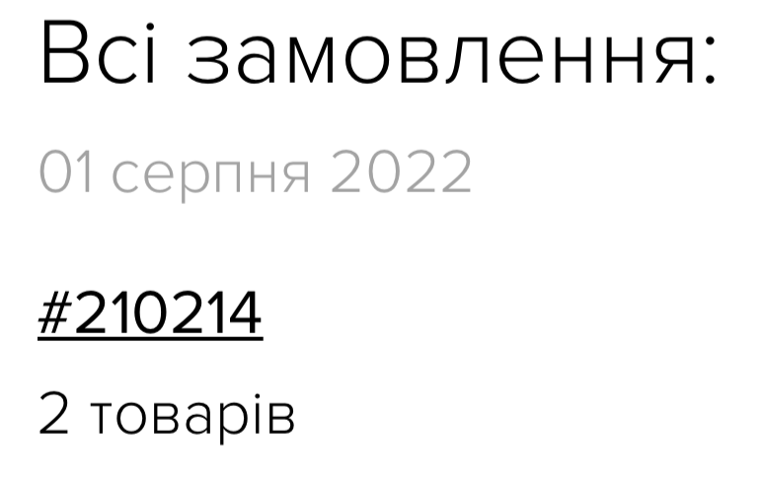
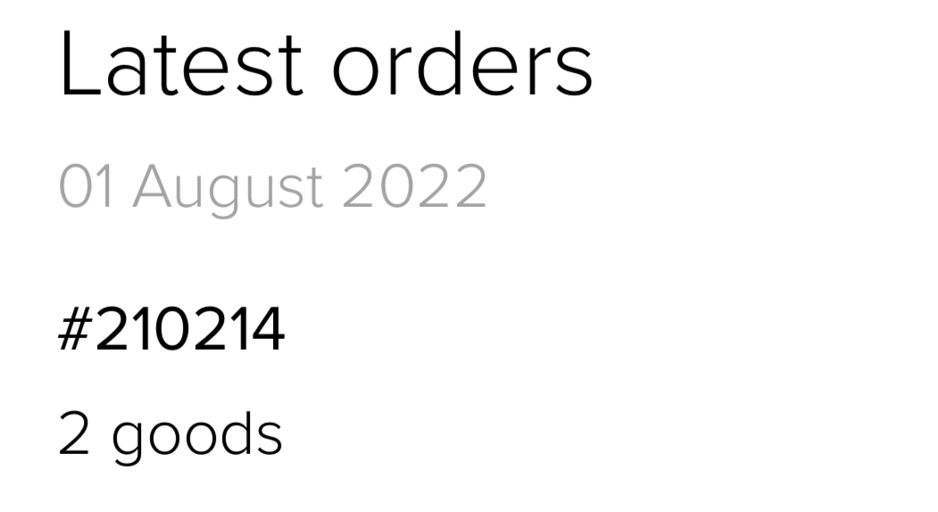
NON-FUNCTIONAL TESTING: I18N
Task: Verify that date of sending an email is displayed according to chosen locale.
Internationalization Testing Procedure: Open the application, log in, change the language to English (en) and check the date format
Defect: The date is displayed in Ukrainian format

Slide 16
NON-FUNCTIONAL TESTING: UI
Task: Check the login page’s elements presence, alignment, font, and size.
UI Testing Procedure: Open the login page. Verify that all elements are present, and verify alignment, font, and size.
Result: Pass

Slide 17
NON-FUNCTIONAL TESTING: USABILITY
Task: Verify that the user can buy a product in 3 clicks
Usability Testing Procedure: Click on any button at the top, chose a product, then chose a color and size, and click on the “buy” icon.
Defect: The product is bought in 5 clicks.

Slide 18
NON-FUNCTIONAL TESTING: SECURITY
Task: Verify that the user returns to the ‘Login’ page and can't use any functionality in the account, while another user using the same account on another device has changed the password.
Security Testing Procedure: Open a home page, log in, then open the home page on any other device, enter the same email address and password, and change the password in the account.
Defect: The user doesn’t return to the ‘Login’ page, the user continues to use the account

Slide 19
NON-FUNCTIONAL TESTING: COMPATIBILITY
Task: Verify that website can work with Safari and Google Chrome browsers.
Compatibility Testing Procedure: Open Safari, open the website, log in, and try to buy a product. Open Google Chrome, open the website, log in, and try to buy a product.
Result: Pass. The website works correctly on both browsers.

Slide 20
CONFIRMATION TESTING
Task: Test the ability to buy a product
Functional Testing Procedure: Run steps of the failed Test Cases and confirm that the defect is fixed.
Type in a search field category and name of the product chose details, try to order, and verify that product appears in the list.
Defect: After searching, the product doesn’t appear in the list.

Slide 21
REGRESSION TESTING
Task: Test ability to buy product when type only name without category.
Regression Testing Procedure: Open the website, type in a search field name of the product, chose details, try to order, and verify that product appears in the labels list.
Result: Pass. The website gives a correct answer when typing only Albina.

Slide 22
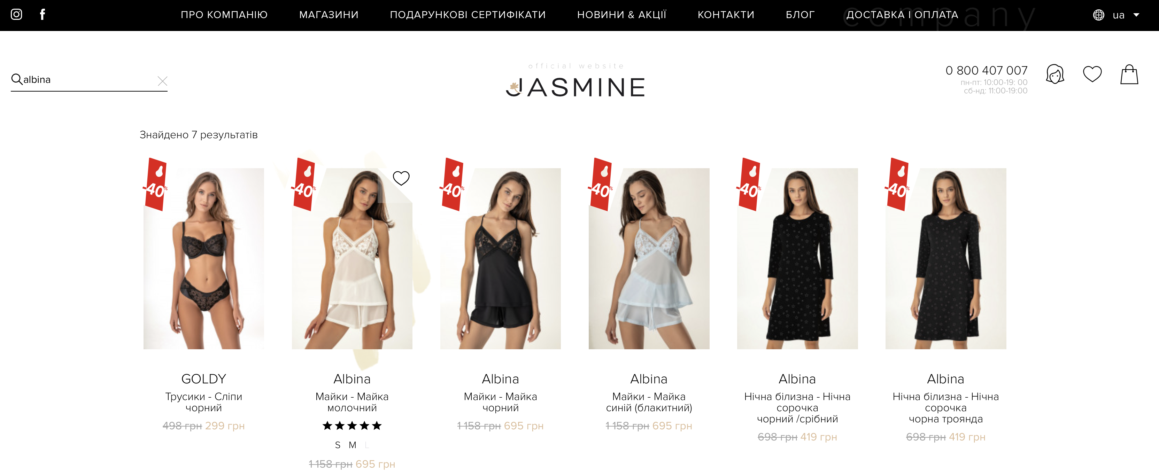

Slide 23



